Slide 1
MiCOM P40 Techncial Training
MiCOM 143 PSL Configuration
Notes:
This is an example of a Title Slide. We need to convey Life Is On in everything we do, so try to lead with compelling images that are vibrant, authentic, and human. The human element should be apparent and within the context of a segment that we touch.
To keep this PowerPoint template file size reduced, we included a small library of image choices in the Slide Master (under View). You can also get them from the SE Asset Library: https://schneiderelectric.telescopeondemand.com

Slide 2
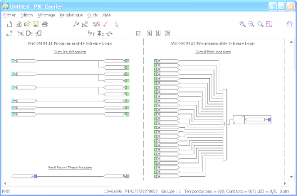
PSL Configuration
PSL Editor is a software for Px40 relays – it allows :
  to assign logic inputs
  to assign output contacts
  to assign user defined LED’s
  to assign Fault Record Trigger
  to built complex logic equations
    using AND, OR, NOT gates
    using timers
General
Notes:
This is an example of a Text Slide. Reference the different layout options in the Slide Master (under the View tab) for different variations. Remember, our new Brand Guidelines call for clean and simple messages and design. Reference the PowerPoint Guidelines on the Brand Book for tips and useful information on creating effective presentations.

Slide 3

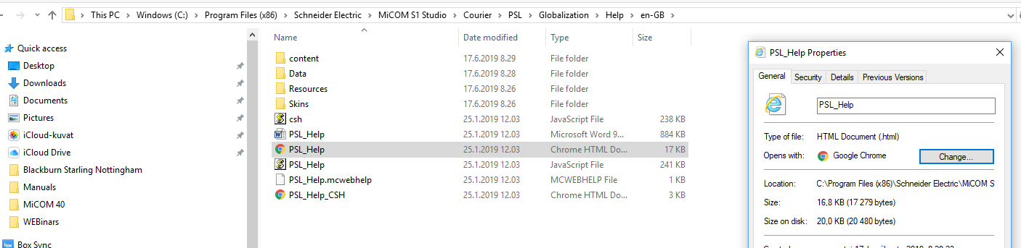
PSL Configuration
Help Function
Help topics will give you all information required to built a PSL:
  All menus description
  All icons description
  Browser needs to be changed to e.g. Google Crome
Notes:
This is an example of a Text Slide. Reference the different layout options in the Slide Master (under the View tab) for different variations. Remember, our new Brand Guidelines call for clean and simple messages and design. Reference the PowerPoint Guidelines on the Brand Book for tips and useful information on creating effective presentations.

Slide 4

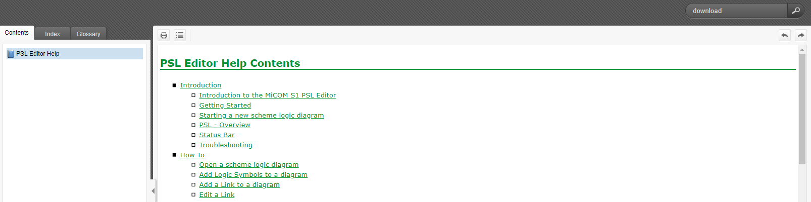
PSL Configuration
Help function
Search for specific topic
Notes:
This is an example of a Text Slide. Reference the different layout options in the Slide Master (under the View tab) for different variations. Remember, our new Brand Guidelines call for clean and simple messages and design. Reference the PowerPoint Guidelines on the Brand Book for tips and useful information on creating effective presentations.

Slide 5
PSL Configuration
Mouse pointer
  allow to select an object and move it
  allow to edit object properties (right click)
Pan tool
  move inside the canvas without using horizontal or vertical scroll bars
Zoom tools
Link
  to link two objetcs :
    when the pointer is close to the connection point it will change to a target (a cross in a circle).
    click while the pointer is a target
    right-click or press ESC to disable link mode
Notes:
This is an example of a Text Slide. Reference the different layout options in the Slide Master (under the View tab) for different variations. Remember, our new Brand Guidelines call for clean and simple messages and design. Reference the PowerPoint Guidelines on the Brand Book for tips and useful information on creating effective presentations.

Slide 6
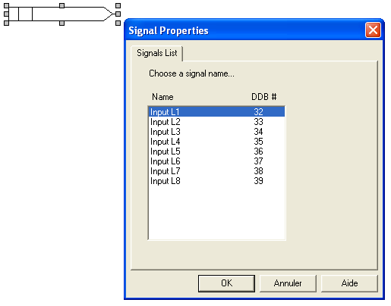

PSL Configuration
How to configure an opto input :
  Select « Opto Signal » icon
  Place input on canvas then select input number to be assigned
Notes:
This is an example of a Text Slide. Reference the different layout options in the Slide Master (under the View tab) for different variations. Remember, our new Brand Guidelines call for clean and simple messages and design. Reference the PowerPoint Guidelines on the Brand Book for tips and useful information on creating effective presentations.

Slide 7




PSL Configuration
What can be assigned to an opto input
  A LED
  An Output Contact
  A Logic Gate
  An output signal (internal)
  A GOOSE Output (IEC 61850)
Multiple functions can be assigned to one input
Notes:
This is an example of a Text Slide. Reference the different layout options in the Slide Master (under the View tab) for different variations. Remember, our new Brand Guidelines call for clean and simple messages and design. Reference the PowerPoint Guidelines on the Brand Book for tips and useful information on creating effective presentations.

Slide 8

PSL Configuration
Setting groups change with opto inputs :
  Logic Inputs 1 & 2 must be used if setting group switchover is controlled by opto inputs.
    Input 1=0, Input 2=0 =>Group 1 active
    Input 1=1, Input 2=0 =>Group 2 active
    Input 1=0, Input 2=1 =>Group 3 active
    Input 1=1, Input 2=1 =>Group 4 active
Notes:
This is an example of a Text Slide. Reference the different layout options in the Slide Master (under the View tab) for different variations. Remember, our new Brand Guidelines call for clean and simple messages and design. Reference the PowerPoint Guidelines on the Brand Book for tips and useful information on creating effective presentations.

Slide 9
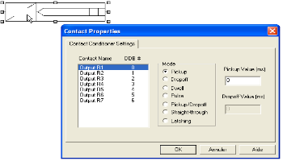

PSL Configuration
Assigning an output contact
  Select « Contact conditioner » icon
  Place contact on canvas and select contact number to be assigned
Notes:
This is an example of a Text Slide. Reference the different layout options in the Slide Master (under the View tab) for different variations. Remember, our new Brand Guidelines call for clean and simple messages and design. Reference the PowerPoint Guidelines on the Brand Book for tips and useful information on creating effective presentations.

Slide 10
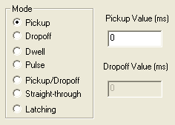
PSL Configuration
A timer can be configured to the contact :
Pick up
1
1
1
Drop off
2
2
2
Dwell
1
1
1
Pulse
2
1
1
Notes:
This is an example of a Text Slide. Reference the different layout options in the Slide Master (under the View tab) for different variations. Remember, our new Brand Guidelines call for clean and simple messages and design. Reference the PowerPoint Guidelines on the Brand Book for tips and useful information on creating effective presentations.

Slide 11
PSL Configuration
  Pickup/Dropoff = both pickup and dropoff timers
  Straight-through = no timer assigned on the contact
  Latching = Contact is active until Reset (manual or automatic)
Notes:
This is an example of a Text Slide. Reference the different layout options in the Slide Master (under the View tab) for different variations. Remember, our new Brand Guidelines call for clean and simple messages and design. Reference the PowerPoint Guidelines on the Brand Book for tips and useful information on creating effective presentations.

Slide 12



PSL Configuration
Assigning an output contact
  A logic Input
  A repeated LED status
  A Hotkey control (front panel)
  Logic gate output
  An input signal (internal)
  A GOOSE Input (IEC 61850)
Only one function or logic equation can be assigned to an output contact
Notes:
This is an example of a Text Slide. Reference the different layout options in the Slide Master (under the View tab) for different variations. Remember, our new Brand Guidelines call for clean and simple messages and design. Reference the PowerPoint Guidelines on the Brand Book for tips and useful information on creating effective presentations.

Slide 13
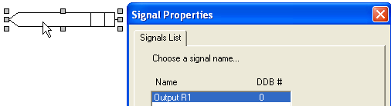

PSL Configuration
Contact position can be used as an input signal
  by using directly contact conditioner output
  by creating a signal contact copy (equivalent)
Notes:
This is an example of a Text Slide. Reference the different layout options in the Slide Master (under the View tab) for different variations. Remember, our new Brand Guidelines call for clean and simple messages and design. Reference the PowerPoint Guidelines on the Brand Book for tips and useful information on creating effective presentations.

Slide 14
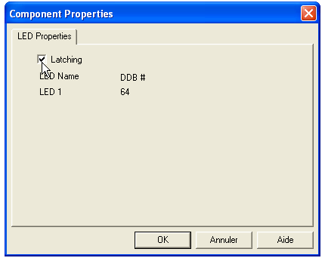
PSL Configuration
LEDs can be latched
Notes:
This is an example of a Text Slide. Reference the different layout options in the Slide Master (under the View tab) for different variations. Remember, our new Brand Guidelines call for clean and simple messages and design. Reference the PowerPoint Guidelines on the Brand Book for tips and useful information on creating effective presentations.

Slide 15
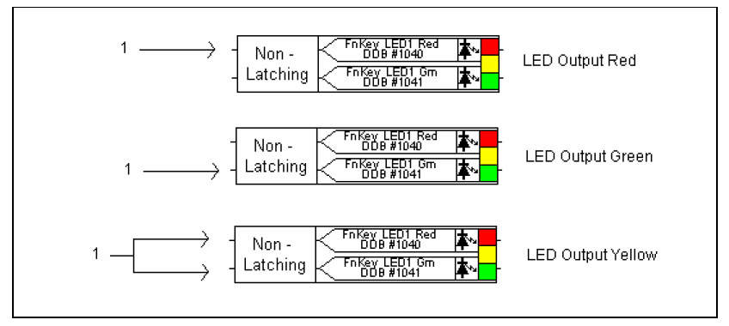
PSL Configuration
Choose the display color according to the inputs if available
LED can be latched (one setting for the 3 colors)
Notes:
This is an example of a Text Slide. Reference the different layout options in the Slide Master (under the View tab) for different variations. Remember, our new Brand Guidelines call for clean and simple messages and design. Reference the PowerPoint Guidelines on the Brand Book for tips and useful information on creating effective presentations.

Slide 16
PSL Configuration
Assigning signals to a LED
  A logic Input
  A Hotkey control (front panel)
  Logic gate output
  An input signal (internal)
  A GOOSE Input (IEC 61850)
Only one function or logical equation can be assigned to a LED
Notes:
This is an example of a Text Slide. Reference the different layout options in the Slide Master (under the View tab) for different variations. Remember, our new Brand Guidelines call for clean and simple messages and design. Reference the PowerPoint Guidelines on the Brand Book for tips and useful information on creating effective presentations.

Slide 17
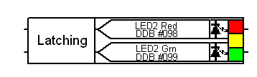
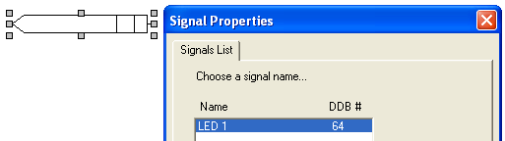
PSL Configuration
  It is possible to use LED status as an input signal :
  or by using directly LED conditioner output
  or by creating a LED signal copy (equivalent) :
Notes:
This is an example of a Text Slide. Reference the different layout options in the Slide Master (under the View tab) for different variations. Remember, our new Brand Guidelines call for clean and simple messages and design. Reference the PowerPoint Guidelines on the Brand Book for tips and useful information on creating effective presentations.

Slide 18
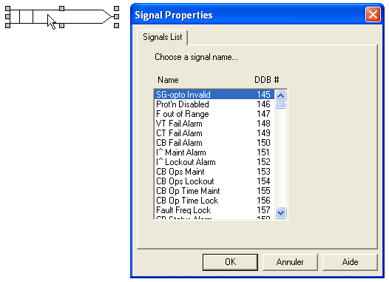
PSL Configuration
Configuring input signals
  Select « Input Signal » icon
  Place signal on canvas and select input signal to be assigned
Notes:
This is an example of a Text Slide. Reference the different layout options in the Slide Master (under the View tab) for different variations. Remember, our new Brand Guidelines call for clean and simple messages and design. Reference the PowerPoint Guidelines on the Brand Book for tips and useful information on creating effective presentations.

Slide 19


PSL Configuration
Input signal are generated by protection functions and can be used in PSL
  To a LED
  To an Output Contact
  To an Logical Gate
  An Output signal (internal)
  A GOOSE Output (IEC 61850)
Several functions can be assigned to one input signal
Notes:
This is an example of a Text Slide. Reference the different layout options in the Slide Master (under the View tab) for different variations. Remember, our new Brand Guidelines call for clean and simple messages and design. Reference the PowerPoint Guidelines on the Brand Book for tips and useful information on creating effective presentations.

Slide 20
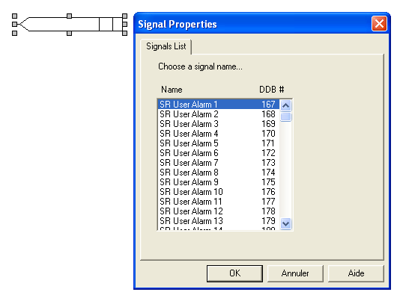

PSL Configuration
Assigning output signals
  Select « Ouput Signal » icon
  Place the signal on canvas and select output to be assigned
Notes:
This is an example of a Text Slide. Reference the different layout options in the Slide Master (under the View tab) for different variations. Remember, our new Brand Guidelines call for clean and simple messages and design. Reference the PowerPoint Guidelines on the Brand Book for tips and useful information on creating effective presentations.

Slide 21
PSL Configuration
Output signal interacts with the protection functions
  signals can be assigned in the PSL to:
  logic Input
  hotkey control (front panel)
  logic gate output
  input signal (internal)
  GOOSE Input (IEC 61850)
Only one function can be assigned to an output signal
  or logical equation result
Notes:
This is an example of a Text Slide. Reference the different layout options in the Slide Master (under the View tab) for different variations. Remember, our new Brand Guidelines call for clean and simple messages and design. Reference the PowerPoint Guidelines on the Brand Book for tips and useful information on creating effective presentations.

Slide 22
PSL Configuration
Fault record trigger disturbance recording when a trip occurs :
  If Fault Record Trigger is not correctly assigned, protection relay will not give any information in case of fault :
    analogue values
    events chronological recording
    which functions have tripped
  Trip LED will remain ON and it will not be possible to release, unless reset from the VIEW RECORDS menu
    Key « C » on the front panel is working only after reading the fault report
Notes:
This is an example of a Text Slide. Reference the different layout options in the Slide Master (under the View tab) for different variations. Remember, our new Brand Guidelines call for clean and simple messages and design. Reference the PowerPoint Guidelines on the Brand Book for tips and useful information on creating effective presentations.

Slide 23
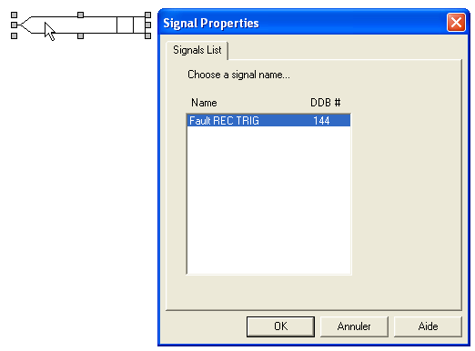

PSL Configuration
Assigning Fault Record Trigger :
  Select « Fault Record Trigger » icon
  Place signal on canvas and select « Fault REC TRIG »
Notes:
This is an example of a Text Slide. Reference the different layout options in the Slide Master (under the View tab) for different variations. Remember, our new Brand Guidelines call for clean and simple messages and design. Reference the PowerPoint Guidelines on the Brand Book for tips and useful information on creating effective presentations.

Slide 24
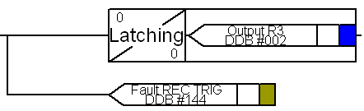
PSL Configuration
Typically fault record trigger will be assigned to trip contact signal (R3) :
In case trip contact is latched :
  Fault Record will operate continously as soon as first trip occur
  Its not possible to view fault records and reset contact R3
  In this case, fault record trigger must be assigned in an other way, for example :
Notes:
This is an example of a Text Slide. Reference the different layout options in the Slide Master (under the View tab) for different variations. Remember, our new Brand Guidelines call for clean and simple messages and design. Reference the PowerPoint Guidelines on the Brand Book for tips and useful information on creating effective presentations.

Slide 25

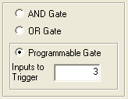
PSL Configuration
To set up a logical gate, select the corresponding icon and put the gate on the canvas :
  « AND » gate
  « OR » gate
  Programmable« OR » gate
    in this example, at least 3 input signals should be present to activate gate output
Notes:
This is an example of a Text Slide. Reference the different layout options in the Slide Master (under the View tab) for different variations. Remember, our new Brand Guidelines call for clean and simple messages and design. Reference the PowerPoint Guidelines on the Brand Book for tips and useful information on creating effective presentations.

Slide 26
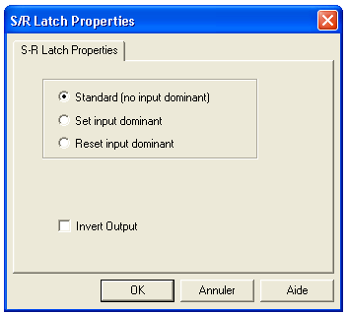

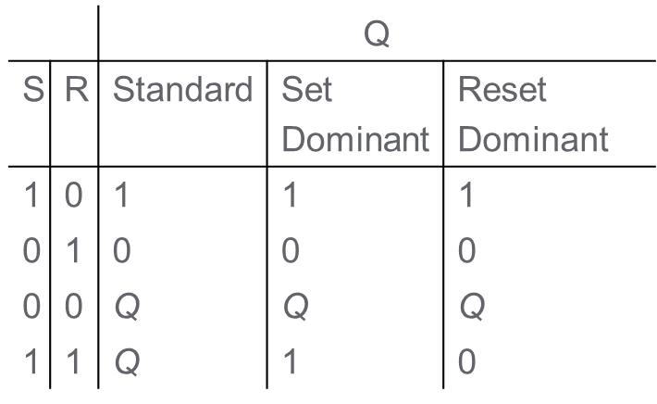
PSL Configuration
Set-Reset gate:
Notes:
This is an example of a Text Slide. Reference the different layout options in the Slide Master (under the View tab) for different variations. Remember, our new Brand Guidelines call for clean and simple messages and design. Reference the PowerPoint Guidelines on the Brand Book for tips and useful information on creating effective presentations.

Slide 27

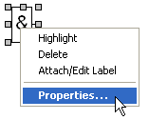


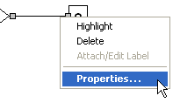



PSL Configuration
logical gate output can be inverted by rightclicking on the gate :
Input can be inverted by rightclicking on the link :
Notes:
This is an example of a Text Slide. Reference the different layout options in the Slide Master (under the View tab) for different variations. Remember, our new Brand Guidelines call for clean and simple messages and design. Reference the PowerPoint Guidelines on the Brand Book for tips and useful information on creating effective presentations.

Slide 28
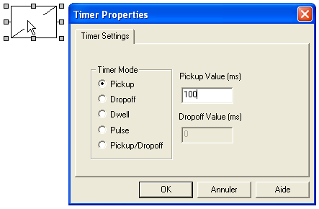

PSL Configuration
Timers can be added to logical equations :
  Select « timre » icon
  Place timer on the canvas and select timer type and duration
Notes:
This is an example of a Text Slide. Reference the different layout options in the Slide Master (under the View tab) for different variations. Remember, our new Brand Guidelines call for clean and simple messages and design. Reference the PowerPoint Guidelines on the Brand Book for tips and useful information on creating effective presentations.

Slide 29
PSL Configuration
Available timers:
Pick up
Drop off
1
1
1
2
2
2
Dwell
Pulse
1
1
1
1
  Pickup/Dropoff = both pickup and dropoff timers
Notes:
This is an example of a Text Slide. Reference the different layout options in the Slide Master (under the View tab) for different variations. Remember, our new Brand Guidelines call for clean and simple messages and design. Reference the PowerPoint Guidelines on the Brand Book for tips and useful information on creating effective presentations.

Slide 30
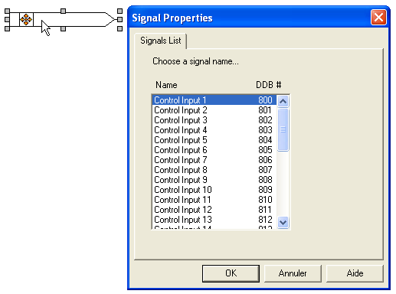
PSL Configuration
Operator can interact with PSL using front panel « Hotkey » :
  Select « Hotkey » icon
  Place signal on the canvas and select virtual control input number
Notes:
This is an example of a Text Slide. Reference the different layout options in the Slide Master (under the View tab) for different variations. Remember, our new Brand Guidelines call for clean and simple messages and design. Reference the PowerPoint Guidelines on the Brand Book for tips and useful information on creating effective presentations.

Slide 31
PSL Configuration
« Hotkey » Control Inputs can be assigned to :
  LED
  Output Contact
  Logical Gate
  Output signal (internal)
  GOOSE Output (IEC 61850)
several functions can assign to one control input signal
Notes:
This is an example of a Text Slide. Reference the different layout options in the Slide Master (under the View tab) for different variations. Remember, our new Brand Guidelines call for clean and simple messages and design. Reference the PowerPoint Guidelines on the Brand Book for tips and useful information on creating effective presentations.

Slide 32

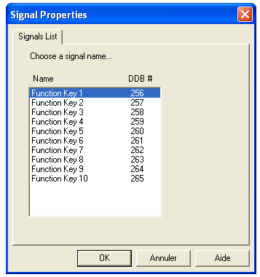
PSL Configuration
  Select « F Key » icon
  Place signal on the canvas and select virtual control input number
Notes:
This is an example of a Text Slide. Reference the different layout options in the Slide Master (under the View tab) for different variations. Remember, our new Brand Guidelines call for clean and simple messages and design. Reference the PowerPoint Guidelines on the Brand Book for tips and useful information on creating effective presentations.

Slide 33
PSL Configuration
« Function Key » can be assigned to :
  LED
  Output Contact
  Logical Gate
  Output signal (internal)
  GOOSE Output (IEC 61850)
several functions can assign to one « F Key »
Notes:
This is an example of a Text Slide. Reference the different layout options in the Slide Master (under the View tab) for different variations. Remember, our new Brand Guidelines call for clean and simple messages and design. Reference the PowerPoint Guidelines on the Brand Book for tips and useful information on creating effective presentations.

Slide 34
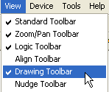
PSL Configuration
In « View » menu, if « Drawing » toolbar is enabled
Text and symbols can be added to the PSL logic
Other toolbars can be displayed in the View menu (check help for complete toolbar description)
Notes:
This is an example of a Text Slide. Reference the different layout options in the Slide Master (under the View tab) for different variations. Remember, our new Brand Guidelines call for clean and simple messages and design. Reference the PowerPoint Guidelines on the Brand Book for tips and useful information on creating effective presentations.

Slide 35
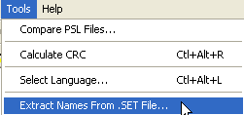

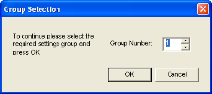








PSL Configuration
labels defined in the setting file .set can be imported to PSL:
  Select the setting file and the setting group where the labels are defined and inputs/outputs/control inputs are renamed
Notes:
This is an example of a Text Slide. Reference the different layout options in the Slide Master (under the View tab) for different variations. Remember, our new Brand Guidelines call for clean and simple messages and design. Reference the PowerPoint Guidelines on the Brand Book for tips and useful information on creating effective presentations.

Slide 36
Notes:
Closing slide

